Slide 1
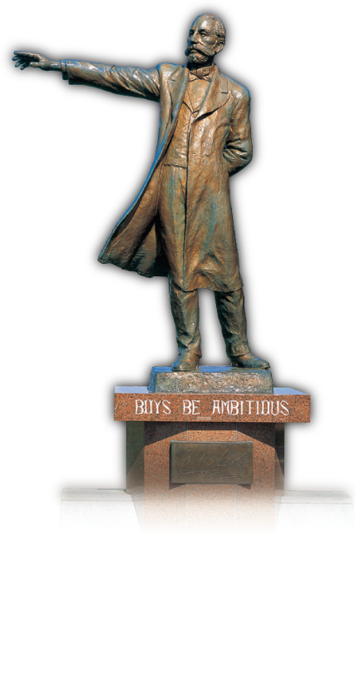
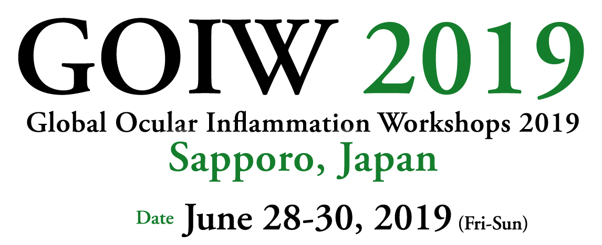
Venue Hokkaido University Conference Hall
Chairman Susumu Ishida, MD, PhD
Professor and Chairman, Department of Ophthalmology,
Faculty of Medicine and Graduate School of Medicine, Hokkaido University
Honorary Chairman Shigeaki Ohno, MD, PhD
Professor Emeritus, Department of Ophthalmology,
Faculty of Medicine and Graduate School of Medicine, Hokkaido University
Department of Ophthalmology, Aishin Memorial Hospital
Secretary General Kenichi Namba, MD, PhD
Associate Professor, Department of Ophthalmology,
Faculty of Medicine and Graduate School of Medicine, Hokkaido University

Slide 2
Features the following Workshops
11th International Workshop on Vogt-Koyanagi-Harada Disease and Sympathetic Ophthalmia
7th International Workshop on Ocular Sarcoidosis
6th International Workshop on Ocular Tuberculosis
5th International Workshop on Ocular Behçet’s disease
2nd International Workshop on Diabetic Retinopathy and Age-Related Macular Degeneration
8th Asia Pacific Intraocular Inflammation Study Group Meeting
Global Ocular Inflammation Workshops Society
President Narsing A. Rao (USA)
Vice President Susumu Ishida (Japan)
Executive Secretary Kalpana babu Murthy (India)
Treasure Soon-Phaik Chee (Singapore)
Board Member Hiroshi Goto (Japan) Shwu-Jiuan Sheu (Taiwan)
Shigeaki Ohno (Japan) Moncef Khairallah (Tunisia)
Russell W. Read (USA) Manabu Mochizuki (Japan)
Hiroshi Takase (Japan) Soumyava Basu (India)
Justine Smith (Australia) Daniel Santos (Brazil)
Massimo Accorinti (Italy)
Advisor Masahiko Usui (Japan)

